Slide 1


Slide 2




Evaluación y Logging en Aplicaciones de IA
Luis Mañez
Chief Architect – ClearPeople LTD
@luismanez
linkedin.com/in/luismanez

Slide 3










Gracias a nuestros patrocinadores

Slide 4
Logging

Slide 5
Semantic Kernel supports OpenTelemetry standard

Slide 6
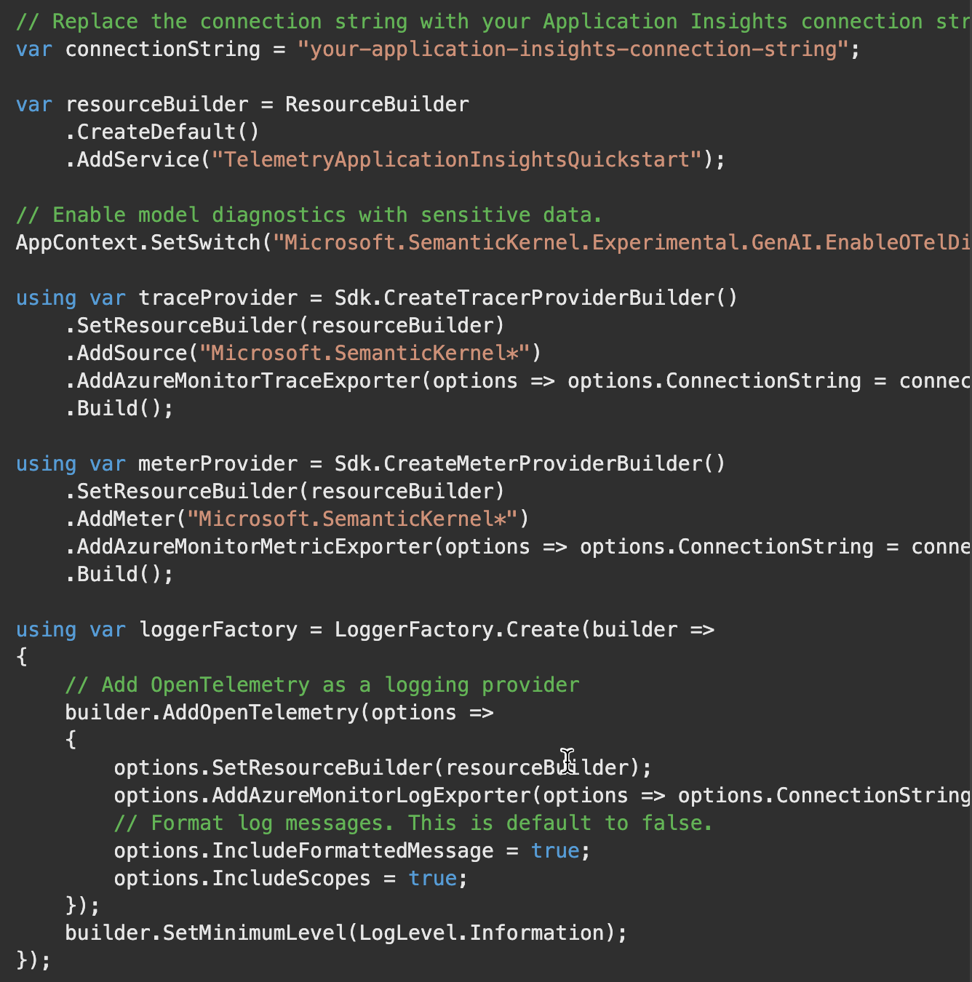

Slide 7
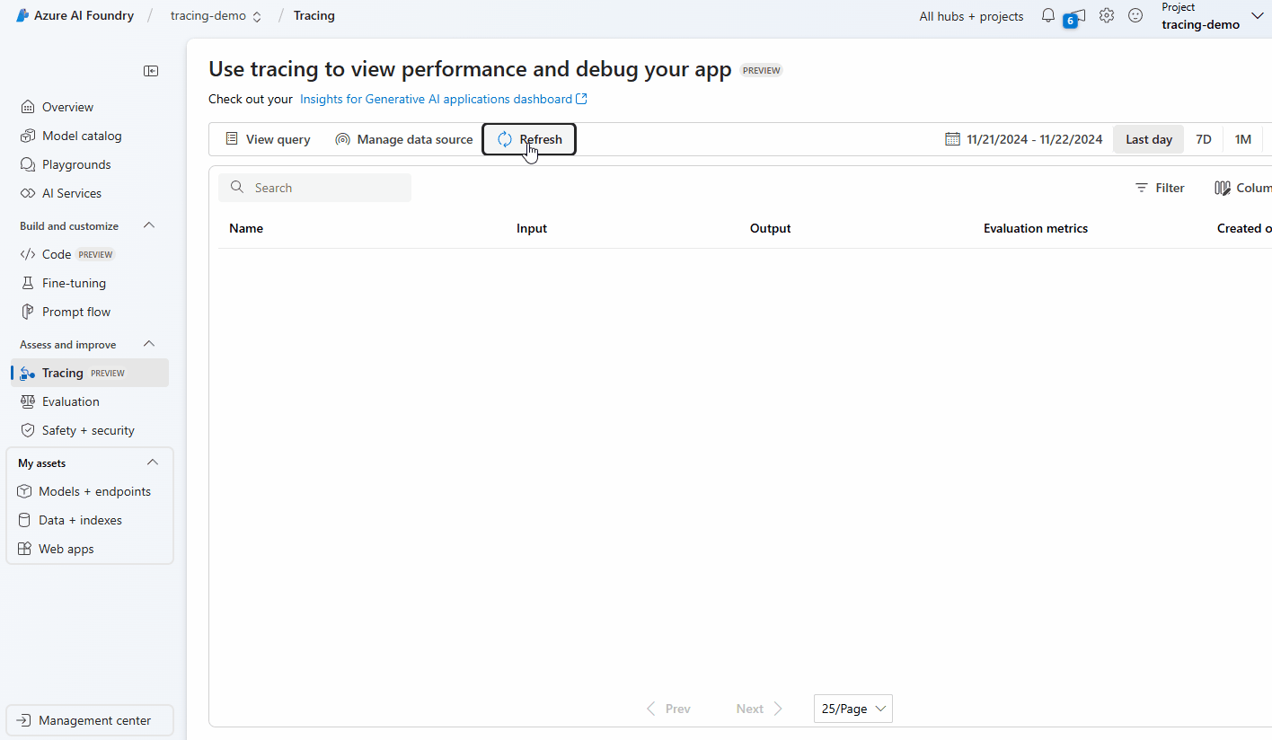

Slide 8
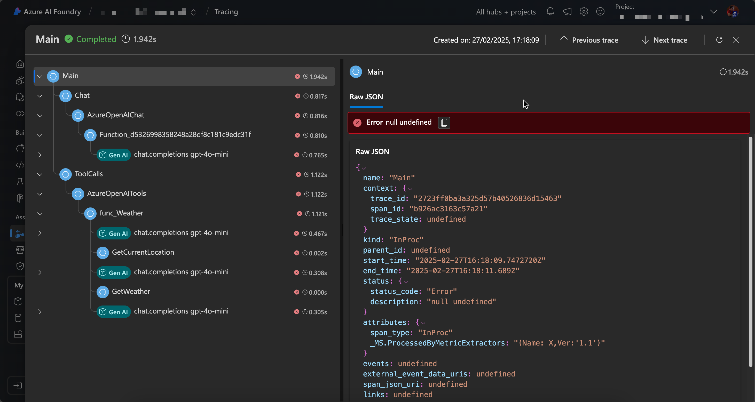

Slide 9
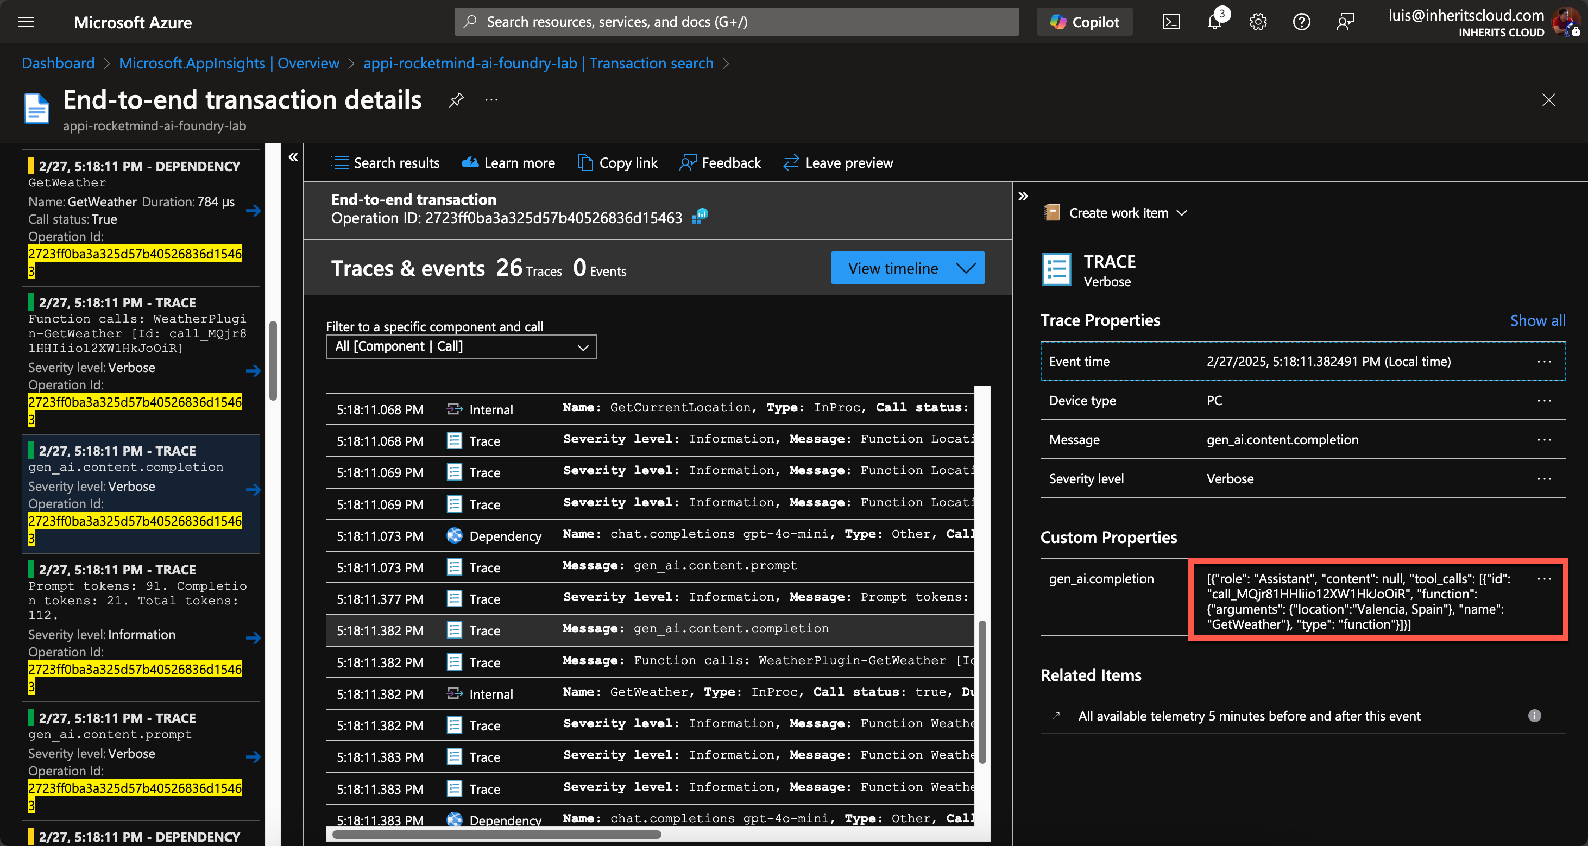

Slide 10
AI Evaluation

Slide 11

How good is our AI solution?
Is our RAG strategy working fine?
Can we use a cheaper model?

Slide 12


Slide 13
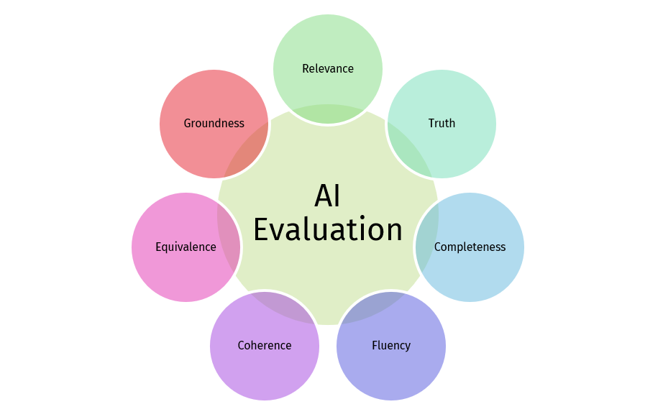

Slide 14
Evaluation criterias
Relevance – Is the AI’s response useful and related to the question or context? Example: You ask about Azure OpenAI, but the AI responds about AWS SageMaker. → Poor relevance.
Coherence – Do the ideas in the response make sense together? Example: The AI says in one sentence that "generative AI does not need data" and in the next that "it requires millions of data points for training." → Poor coherence.
Truth – Is the information provided by the AI factually correct? Example: You ask for the release date of .NET 8, and the AI gives you the wrong date. → Poor truthfulness.
Equivalence – Do two different responses mean the same thing, even if phrased differently? Example:
Response 1: "Azure OpenAI is a service that allows you to use OpenAI models in Microsoft’s cloud."
Response 2: "Azure OpenAI provides access to OpenAI’s AI models through Microsoft’s infrastructure.”
→ Good equivalence, because both responses convey the same meaning.
Completeness – Does the response cover all important aspects, or does it leave out key information? Example: You ask for the steps to deploy a model in Azure Machine Learning, and the AI only gives you half the process. → Poor completeness.
Groundedness – Is the AI’s response based on verifiable sources, or is it "hallucinating" information? Example: You ask for the official .NET roadmap, and the AI responds with something that isn’t in any official source. → Poor groundedness.
Fluency – Is the generated text grammatically correct and easy to read? Example: "Model train Azure upload then works." → Poor fluency.

Slide 15
Azure AI Foundry Evaluation options

Slide 16
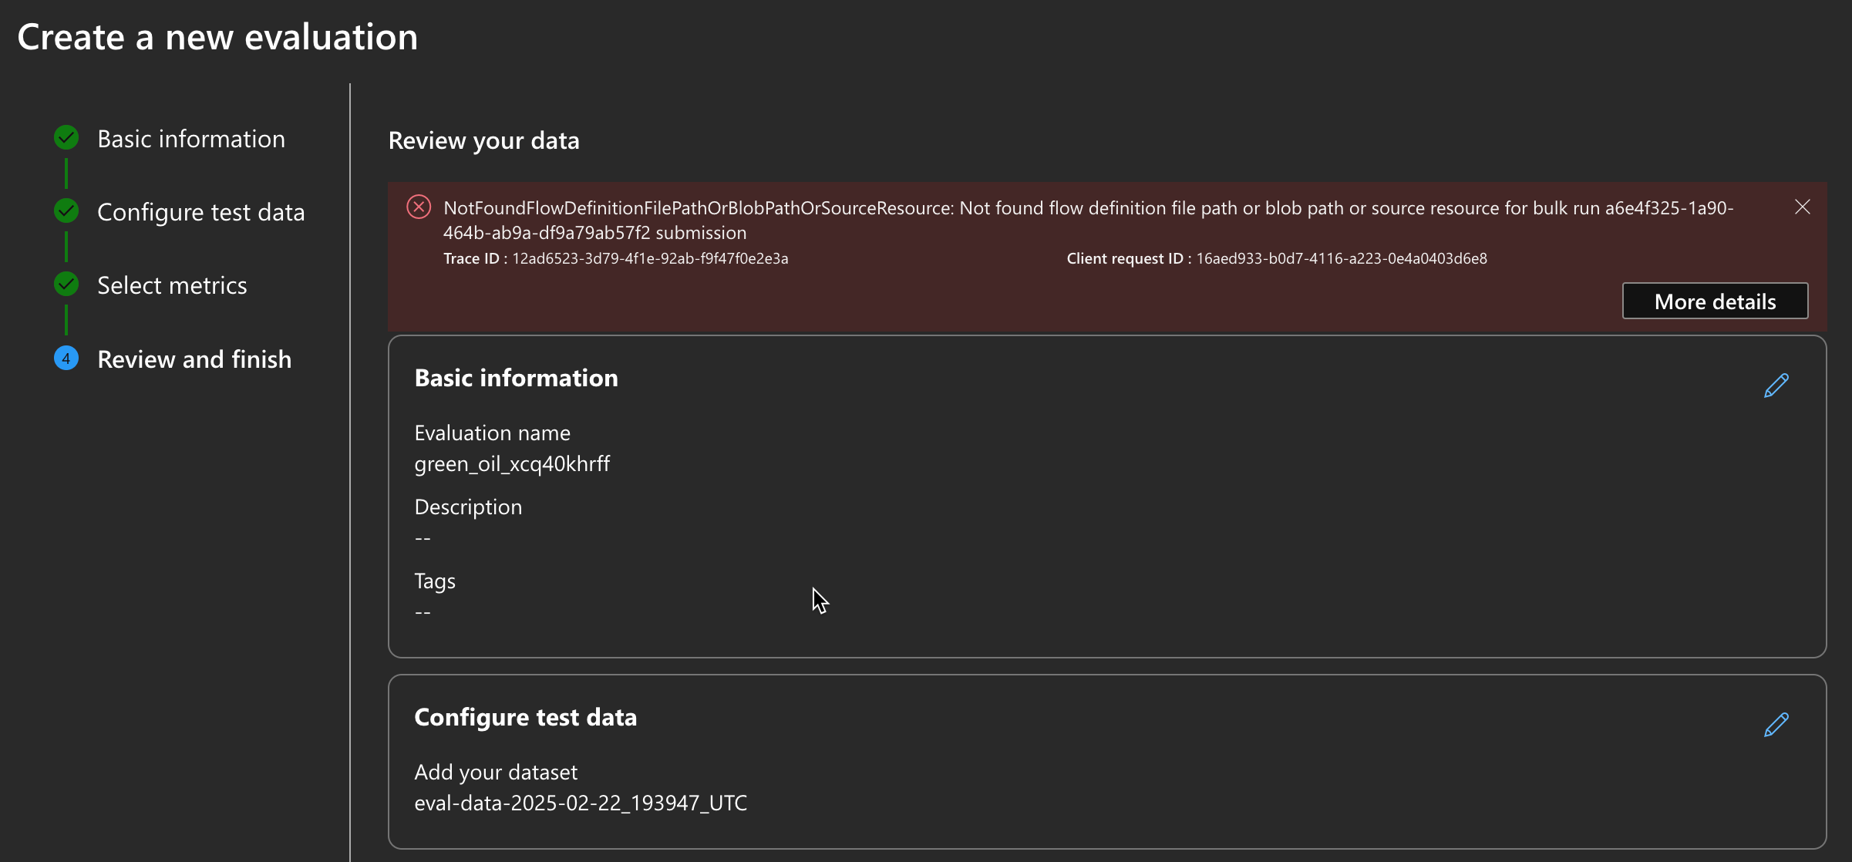


Slide 17
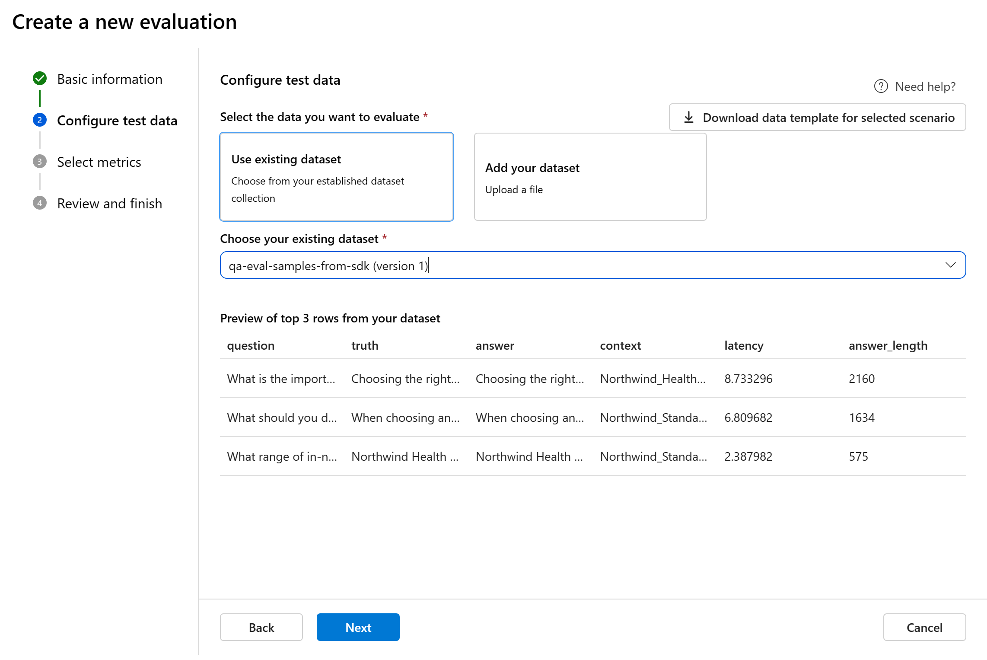
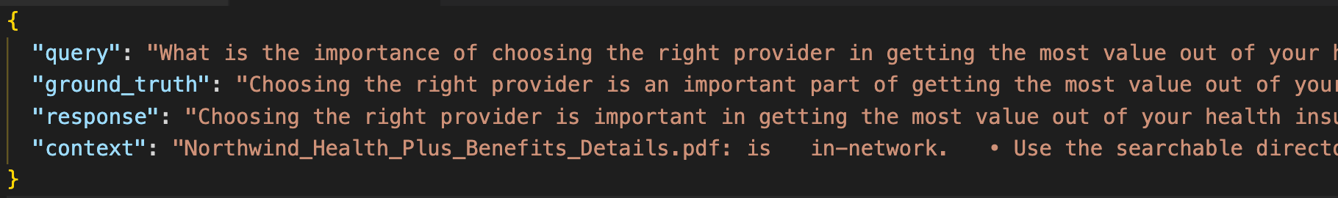
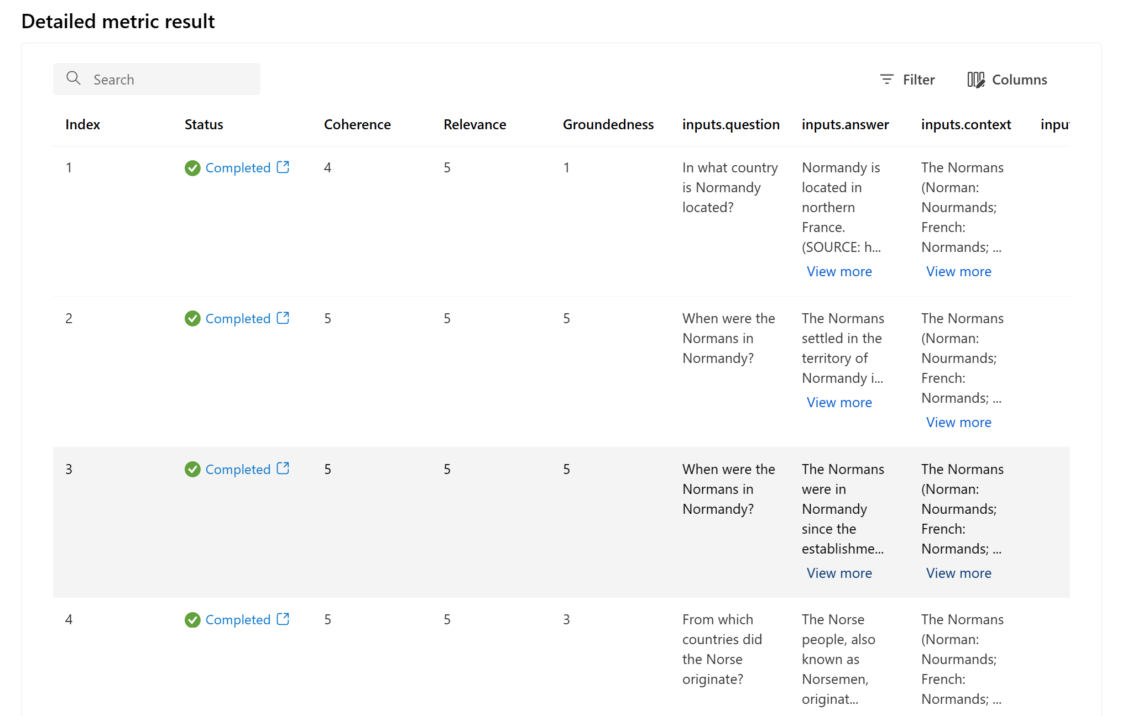

Slide 18
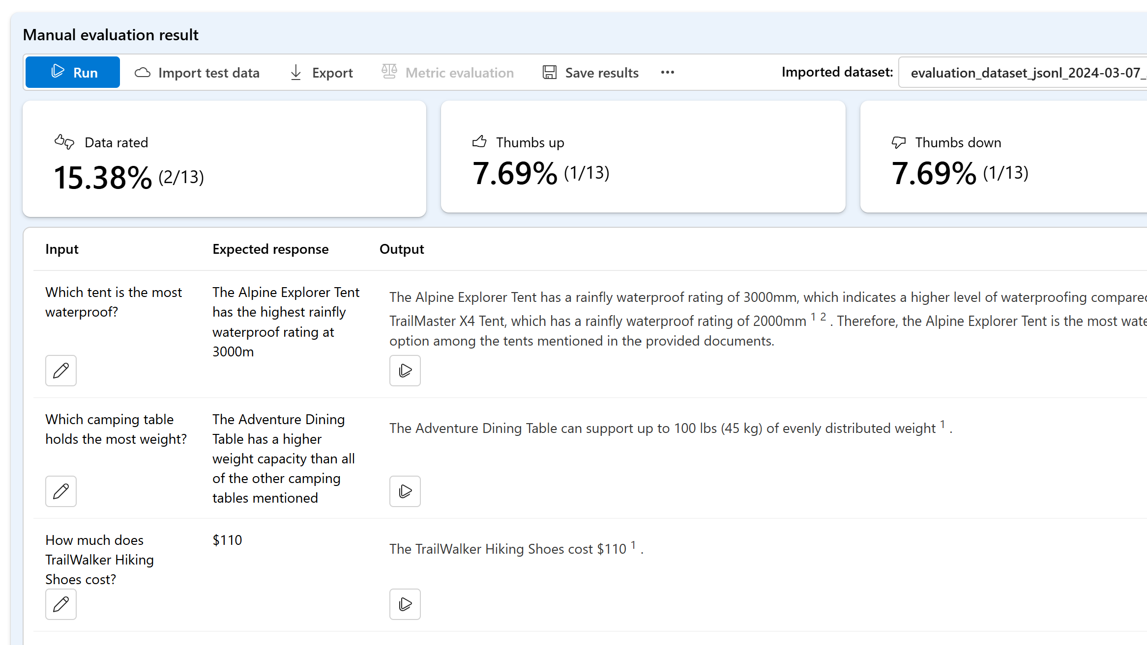

Slide 19
Microsoft Extensions AI Evaluation

Slide 20
Microsoft.Extensions.AI.Evaluation – Defines the core abstractions and types for supporting evaluation.
Microsoft.Extensions.AI.Evaluation.Quality – Contains evaluators that can be used to evaluate the quality of LLM responses in your projects including Relevance, Truth, Completeness, Fluency, Coherence, Equivalence and Groundedness.
Microsoft.Extensions.AI.Evaluation.Reporting – Contains support for caching LLM responses, storing the results of evaluations and generating reports from that data. Uses the FileSystem to store the data.
Microsoft.Extensions.AI.Evaluation.Reporting.Azure – Same as Reporting but uses Azure Storage to store the data.
Microsoft.Extensions.AI.Evaluation.Console – A command line dotnet tool for generating reports and managing evaluation data.
https://github.com/dotnet/extensions/issues/5933

Slide 21
Evaluators
Microsoft.Extensions.AI.Evaluation.Quality
GroundednessEvaluator
EquivalenceEvaluator
Query
Context
Response
Ground truth
RelevanceTruthAndCompletenessEvaluator
CoherenceEvaluator
FluencyEvaluator

Slide 22

Reporting
Microsoft.Extensions.AI.Evaluation.Reporting
Evaluator
DiskBasedReportingConfiguration
Evaluator
Evaluator
ChatConfiguration
AzureStorageReportingConfiguration
IChatClient
Reporting Configuration
EvaluationResult
Question / Query
Answer from RAG System
Evaluator Additional context
ScenarioRun

Slide 23

It´s Demo Time!

Slide 24
https://github.com/luismanez/global-ai-madrid-2025

Slide 25
Gracias a nuestros patrocinadores

